Slide 1
IT1762
Data Structures & Algorithms
Topic 3A Methods
with parameter passing

Slide 2
Topics
Review of Methods
Passing data using parameters in methods
Objectives:
Know how to pass data between methods using parameter passing.

Slide 3

Review:
What is a method?
Large program:
  It is difficult to understand and debug
  To reduce complexity is to split a program into (relatively) isolated sections
  It helps to focus on an isolated section without distraction of the complete program
  In C#, such section are known as methods
  To use a method, is to call it.
  Example:
    MessageBox.Show()
      Calling a system provided method to display a message box
    Validate_Value()
      Calling your own method to perform certain tasks

Slide 4
Review :
Why use methods?
Good for program organization
  Partitions large programs into smaller, manageable units
  Simplifies programming & debugging
Avoiding repetition of code
  Avoids writing the same code over and over again.
Independence
  Methods developed in one program may be incorporated into others.

Slide 5
Review : Passing data between methods
Methods can pass data to each other as follows:
  Through Class Variables
  By using Parameters
  By returning a value from a method.
We have covered point 1 in IT1753
What is a Class Variable?

Slide 6
Review : Passing data between methods
Use of class variables for passing data between methods has disadvantages:
  It is not clear what are the inputs and outputs of the method.
  Variables are not protected against changes by other methods
  A method using class variables loses its reusability.

Slide 7
Review Structure of a
Method with NO Parameter
return type: void means the method is not returning any value to the calling program.
Name of method
private void MethodName ( )
{
statement;
statement;
}
a pair of parentheses or round brackets to contain parameters
a pair of braces or curly brackets denote the method body containing C# statements

Slide 8
Structure of a
Method with Parameter
Methods can pass data to each other as follows:
  Through Class Variables
  By using Parameters
  By returning a value from a method.

Slide 9
Structure of a
Method with Parameter
return type: void means the method is not returning any value to the calling program.
Name of method
Private void MethodName ( parameter )
{
statement;
statement;
}
a pair of parentheses or round brackets to contain parameters
a pair of braces or curly brackets denote the method body containing C# statements

Slide 10
Method Definition with parameters
Syntax :
  {
  //statements;
  …
  }
Parameters are places that hold variable values from the calling program.
Parameters must be declared (just like variables)
They are LOCAL variables to the Method
  private void GetPay
  ( double hoursWorked, double hourlyRate )
  {
  // hoursWorked and hourlyRate
  // are local variable here statements
  }
private void MethodName(parameters)
GetPay is the method name
Parameters are hoursWorked and hourlyRate

Slide 11
Method Execution with arguments
When the method is executed or called, the values passed into the method are known as arguments:
  Private void Method1()
  {
  … //Method1 calls Method2
  Method2(arguments);
  …
  }
These arguments must be of the same data type as the parameters defined in the method. Hence hourClocked, 10.5 are both double type
GetPay( hourClocked, 10.5 )
 When passing argument, only values are copied into the method.
hourClocked value is copied to hoursWorked and 10.5 is copied to hourlyRate

Slide 12
Example #1
Method with parameter - FindMax
Private void MethodA()
{
int mark1, mark2;
mark1=int.Parse(
txtmark1.Text));
mark2=int.Parse(
txtmark2.Text);
FindMax(mark1,mark2);
}
Private void FindMax (
int num1, int num2)
{
int max = num1;
if ( num2 > max)
max = num2;
MessageBox.Show
(“maximum=” + max);
}
(1) User enters 2 marks. Data is stored into mark1, mark2
1
(2) MethodA calls FindMax() and passes in mark1, mark2
mark1
mark2
2
20
18
3
20
18
num1
num2
4
(3) A copy of values of mark1 and mark2 is passed to num1 and num2
(4) FindMax() receives values; calculates & displays the maximum. When it completed, it returns to the caller.
Return to caller

Slide 13

Example #2
Method with parameter – ShowName
Write a method named ShowName, with one string parameters. It should display the supplied name in a message box.
Some part of the code is provided, fill in the details:
// method with no return value, receives 1 parameters
private void ShowName ( string name )
{
MessageBox.Show(“Supplied name is ” +
___________);
}

Slide 14
Example #3
Method with parameter – DisplayEarning
Write a method named DisplayEarnings, with two integer parameters representing an employee’s salary, and number of years they have worked. The method should display their total earnings in a message box, assuming that they earned the same amount every year
Some part of the code is provided, fill in the details:
// method with no return value, receives 2 parameters
private void DisplayEarning( int ______, int ______ )
{
float total;
total = ________ * ________ ;
MessageBox.Show(
“total is” + ___________);
}

Slide 15
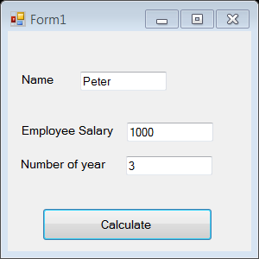
Example #4
Testing your Method with parameter
Try out your DisplayEarning and ShowName method you have written by building a simple GUI with text boxes, label and message boxes as required. Use a Calculate button click to execute your method
Note that supplier name , employee’s salary, and number of years values are read from textboxes.
Debug the application and trace how parameters are passed into methods.

Slide 16
Summary
Methods contains sub-tasks of a program
Using a method is termed as calling the method
Know how to pass data between methods using parameter passing.
Parameters are declared at the method header and not in the method body.
We use parameters so that we can avoid using class variables.

Slide 17
Spot the ERRORs
private void MethodA ( x )
{
MessageBox.Show(“value is ” + x);
}
private void MethodB( ) ;
{
int y=10;
float z=9.0;
MethodA(y);
MethodA(z);
}

Slide 18
Spot the ERRORs
private void MethodA ( x )
{
MessageBox.Show(“value is ” + x);
}
private void MethodB( ) ;
{
int y=10;
float z=9.0;
MethodA(y) ;
MethodA(z) ;
}
The method header must include type name
  Correction>> private void MethodA (int x)
There is NO “ ; ” in method header
The parameter and argument MUST be of the same type. Here z is float but x is int.
1
2
3
1
2
3

Slide 19
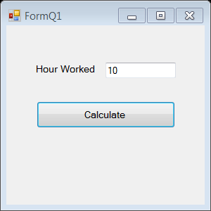
Practical 3A
1a) Write a method CalculatePay( ) that receives a variable, hrsWorked –i.e. number of hours worked, as a parameter. Display the computed pay in a message box.
private _______ CalculatePay( int ______ )
{
float pay;
pay = ___________ ;
MessageBox.Show( ___________);
}
1b) Create a window application to test the CalculatePay method you have written. You application is done with a simple GUI with text boxes, label and message
boxes as required.
User clicks on Calculate button
to execute your code.
Pay = $12 per hour x number of hours worked

Slide 20
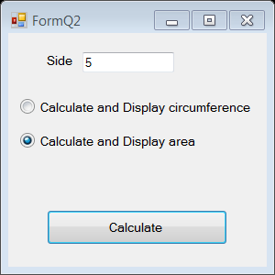
Practical 3A
2. Write a window application using simple GUI with textboxes,
labels, radio button to do the following:
It reads a value from a textbox into a variable called side
User selects an option using radio button.
The options are
  Calculates and displays the circumference,
    where circumference = 4 * side.
  Calculates and displays the area,
    where area = side * side.
c. When user clicks on Calculate button, it calls the respective method.
Both calculations of circumference and area are implemented as methods that receive a parameter, double side. Here is a sample code to help you!
private void CalculateCircumference( ___________ )
{
double ________________ ;
circumference = _________________ ;
MessageBox.Show(________________________ );
}

Slide 21
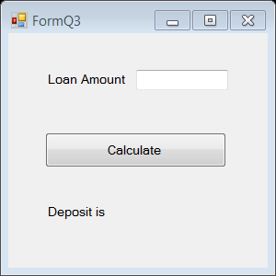
Practical 3A
3. Write a window application using simple GUI with
textboxes, labels, button to do the following:
It reads in a home loan amount (in dollars) from a textbox.
User clicks on Calculate button, it calls a method called CalculateDeposit. It receives the loan amount as a parameter then calculates and displays the required deposit in a label. The deposit is calculated based on the schedule below.
Loan ($) Deposit ($)
Greater than $300,000 $10,000 + 15% of loan
$100,000 - $300,000 $5,000 + 10% of loan
Less than $100,000 5% of loan

Slide 22
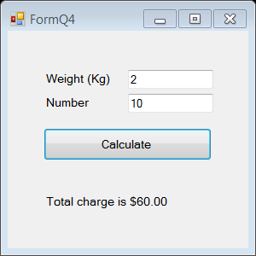
Practical 3A
4. Write a window application using simple GUI with
textboxes, labels, button to do the following:
It reads in the weight of a parcel (in kg) from a textbox
It reads in number of parcels (e.g 3) from a textbox.
User clicks on Calculate button, it calls a method called CalculateCharge which receives 2 parameters, the parcel weight (e.g 1.2kg) and number of parcels (3). It calculates and displays the total postage charge in a label. Assume that all the parcel is of the same weight.
The formula to calculate the charge per parcel is:
Weight (kg) Charge ($/kg)
Greater than 5.0 kg $2.30 / kg
2.5 - 5 kg $2.50 / kg
Less than 2.5 kg $3.00 / kg

Slide 23
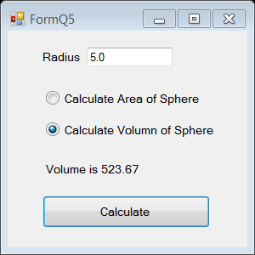
Practical 3A
5. Write a window application using simple GUI with
textboxes, labels, radio button to do the following:
a. It reads in the radius of a sphere from a textbox
b. User chooses an option using radio button.
- Calculate Area of Sphere
- Calculate Volume of Sphere
c. User clicks on Calculate button, the application calls the respective method.
The method CalculateArea receives a parameter, radius. It calculates and displays the area of the sphere in a label. It uses the following formula to calculate Area.
Area = 4 x PI x radius x radius
The method CalculateVolume receives a parameter, radius. It calculates and displays the volume of the sphere in a label. It uses the following formula to calculate the volume.
Volume =4 x PI x radius x radius x radius
3
To format display for 2 decimal places.
Use ToString() Where Vol is the variable and N2 for 2 decimal places.
Vol.ToString(“N2”)

Slide 24
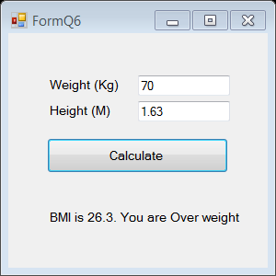
Practical 3A
6. Write a window application using simple GUI with
textboxes, labels, button to do the following:
It reads in the height (in metres) and weight (in kg) of a person.
User clicks on Calculate button. It calls a method called CalculateBMI that receives 2 parameters, the height and weight. It calculates the Body Mass Index (BMI) based on the following formula:
BMI = weight (kg)
height (m) x height (m)
The CalculateBMI method also displays the BMI value and relevant message in a label.
BMI Message to display
Less than 18.5 Under weight
18.5 to below 25 Normal weight
25 to below 30 Overweight
30 and above Obese
To format display for 1 decimal places.
Use ToString() Where BMI is the variable and N1 for 1 decimal places.
BMI.ToString(“N1”)

Slide 25
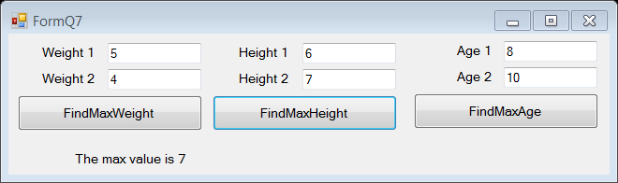
Practical 3A
Reusability of method
7. Write a method FindMax that receives 2 float parameters, display the greater value in a label.
Write a window application using simple GUI with textboxes, labels, button to do the following:
It reads in weights (in KG) of 2 persons from 2 textboxes.
User clicks on FindMaxWeight button. It calls FindMax method and passes in the 2 weight variables. It displays the greater Weight.
It reads in heights (in M) of 2 persons from 2 textboxes.
User clicks on FindMaxHeight button. It calls the above method FindMax method and passes in the 2 height values. It displays the greater height
It reads in age of 2 persons (in Year) from 2 textboxes
User clicks on FindMaxAge button. It calls the above method FindMax and passes in the 2 age values . It displays the older age.
When user clicks on FindMaxHeight, it displays max value is 7 for 7 is bigger than 6.

Slide 26
Practical 3A
Reusability of method
7. Applications:
  How many FindMax method did you write?
  How many times did you call the FindMax method in the application?
  What did you observe in this program? How do you “reuse” Method?
  List the advantage of using method passing parameter.

Slide 27
IT1762
Data Structures & Algorithms
End of
Topic 3A Methods
with parameter passing

